Slide 1
911 Calls For Service 2020 Phase II
Presented By:
Mumtaz Uddin

Slide 2
Data Set
The 911 calls for service 2020 dataset contains Emergency and Non-emergency Police calls to 911 in the Baltimore area and is available through the government website of Baltimore (Baltimore Open Data) that has data for the year 2020.
It has 1.46M rows and 19 columns.
After data cleaning and removing anomalies, the data is approximately 340k rows and 15 columns.

Slide 3
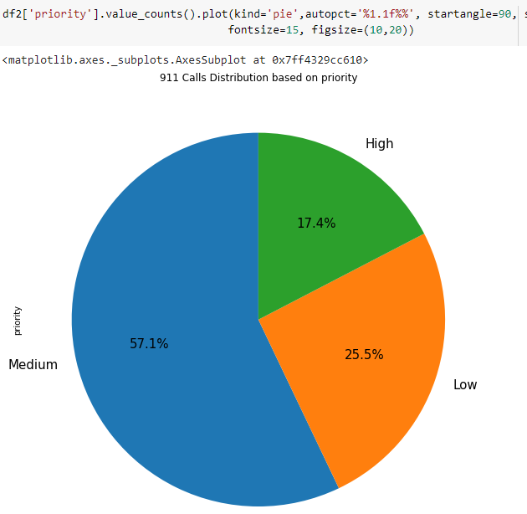
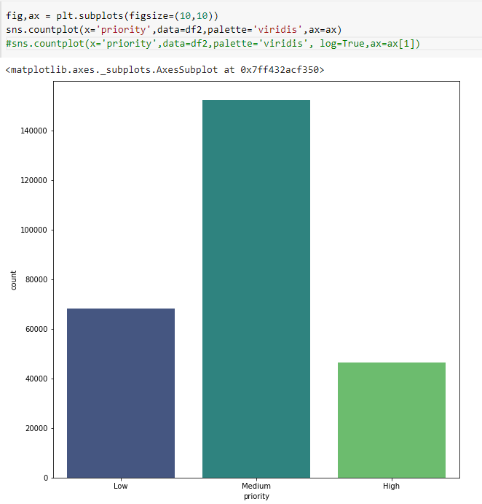
The graphs display the type of priority calls.
The three types are low, medium and high.

Slide 4
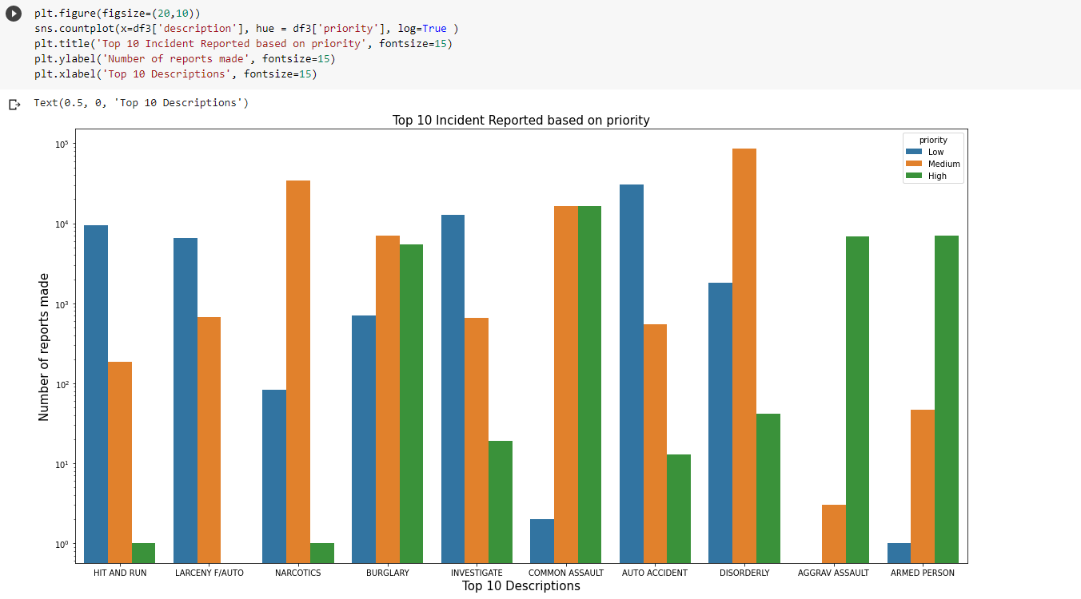
The graphs shows top 10 incidents reported based on the priority and descriptions of the calls.

Slide 5
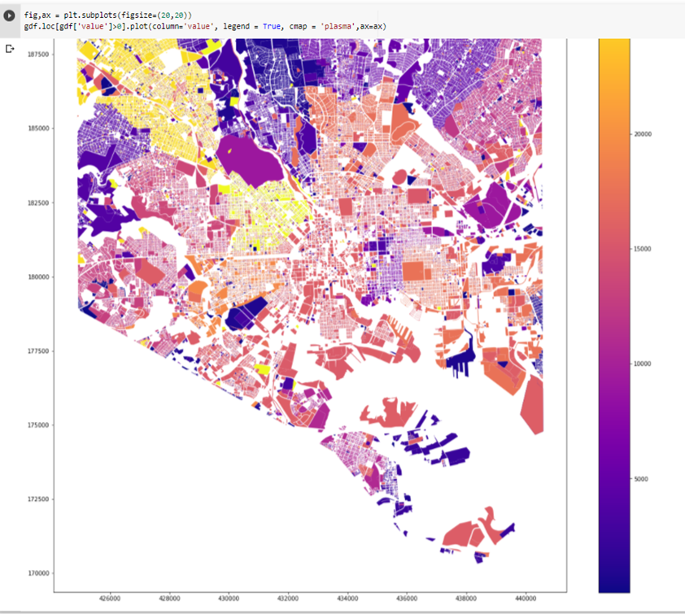
The graphs shows the number of 911 calls based on the geography of the Baltimore area.
Blue shows the range from 0-5000 calls
Violet shows the range from 5000-10000 calls
Pink shows the range from 15000-20000 calls
Orange-Yellow shows the range of 20000+ calls

Slide 6
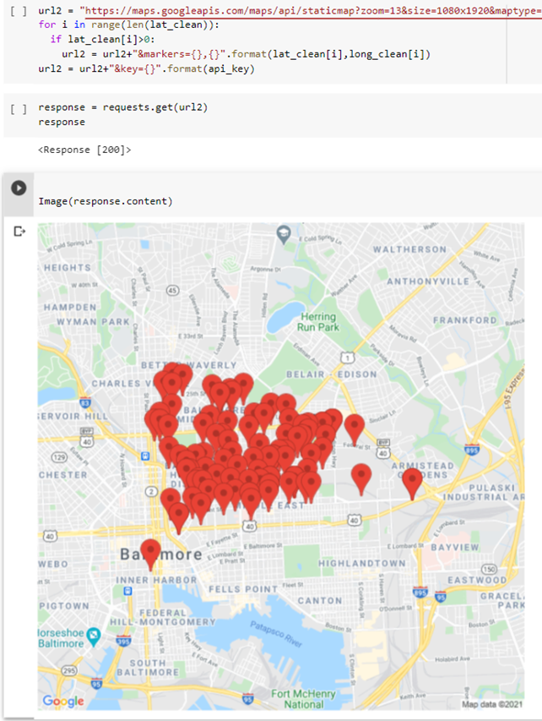
This plot gives a visual representation like google maps. This was achieved using Google API.
The markers help to locate from what location the calls came from.

Slide 7
THANK YOU

